Slide 1
CS 4350: Fundamentals of Software Engineering Lesson 1.1 Course Introduction
Jonathan Bell, Adeel Bhutta, Ferdinand Vesely, Mitch Wand
Khoury College of Computer Sciences
Update all copyright lines ☺
© 2022 Released under the CC BY-SA license

Slide 2
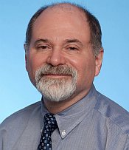

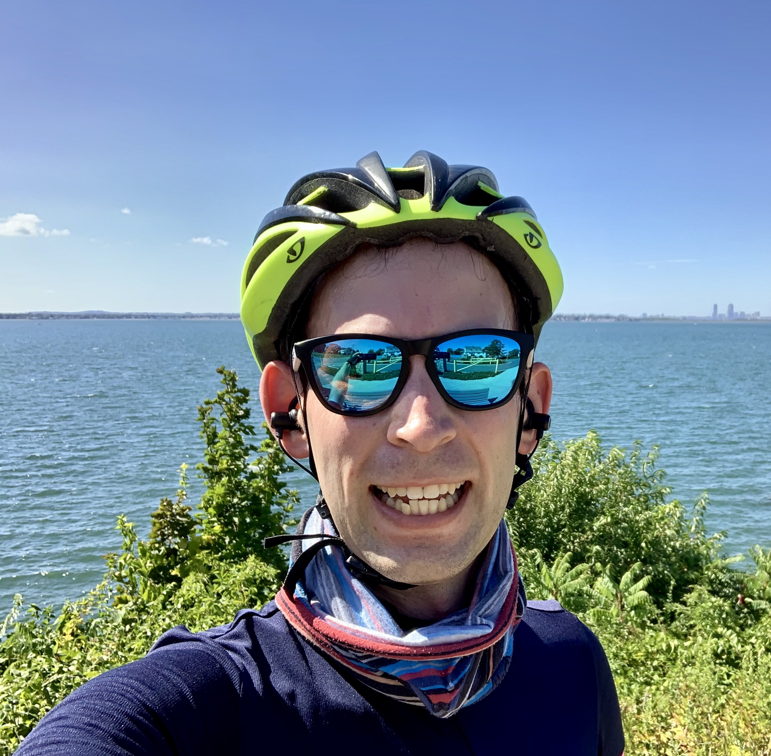
Instructors
Need New Pix
Mitch Wand
John Boyland
Jonathan Bell

Slide 3
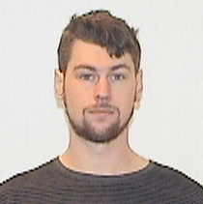

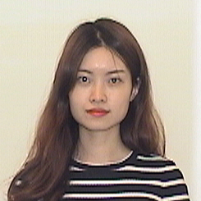
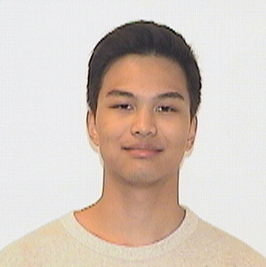
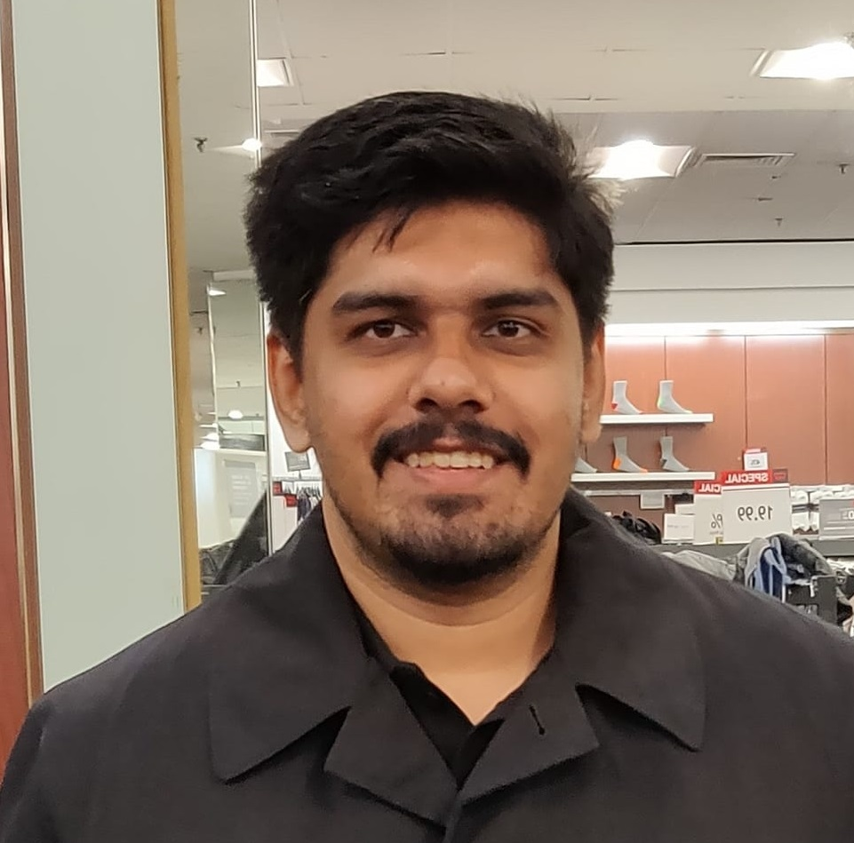
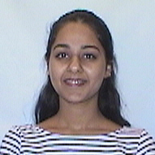
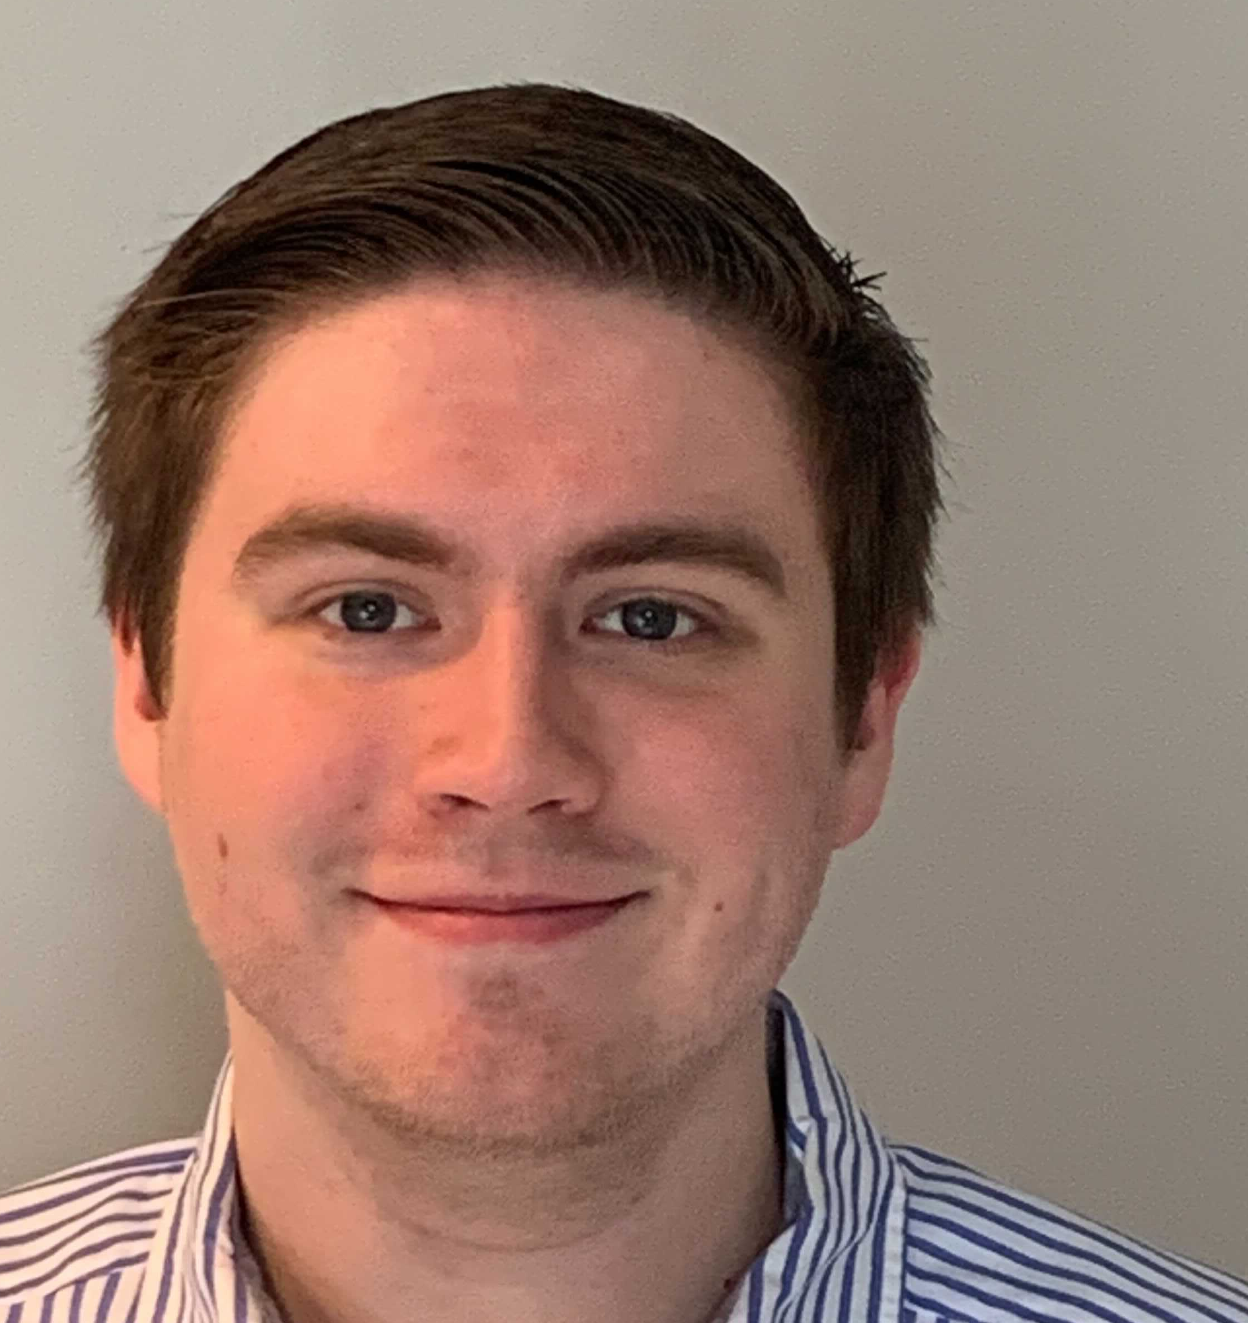
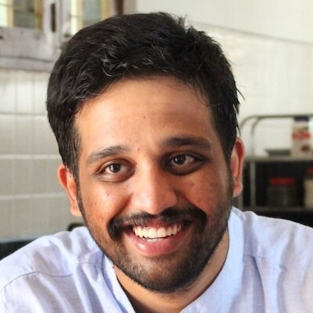
Teaching Assistants
Need New Pix
Joseph Burns
Michael Davinroy
Yuting Gan
Eiki Kan
Satyajit Gokhale
Guneet Kaur
Ben Schultze
Sagar Madhu Ayi

Slide 4
Learning Objectives for this Lesson
By the end of this lesson you should be able to:
Explain what SE is and why it’s important
List your weekly obligations as a student
List the requirements for completing the course
Explain how assignments will be graded

Slide 5
What is software engineering?
Software Engineering refers to the tools and processes that we use to
design,
construct, and
maintain programs
over time.

Slide 6
Good code is necessary but not sufficient
Developing software is a systems enterprise
there are many stakeholders
how to determine the requirements?
how to design code for:
reuse, readability, scale? other factors?
how to organize the development process?
how to make sure you've built the right thing?
how to make sure you've built the thing right?

Slide 7


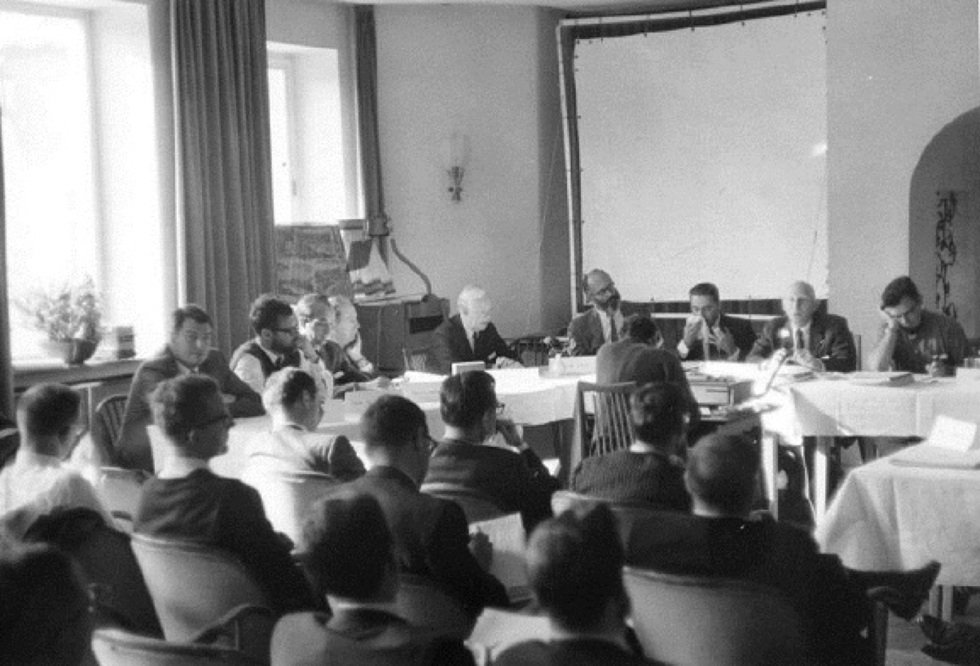
Software Engineering Origins: 1960’s
Projects were unmanageable and code difficult to maintain
Software was of low quality
Software was very inefficient
Software often did not meet requirements
Software was never delivered
Result: a call to action: We must study how to build software

Slide 8

Software Engineering is about People
The major cause of the software crisis is that the machines have become several orders of magnitude more powerful! To put it quite bluntly: as long as there were no machines, programming was no problem at all; when we had a few weak computers, programming became a mild problem, and now we have gigantic computers, programming has become an equally gigantic problem.
-- Edsger W. Dijkstra, in his Turing Award acceptance speech (1972!)

Slide 9
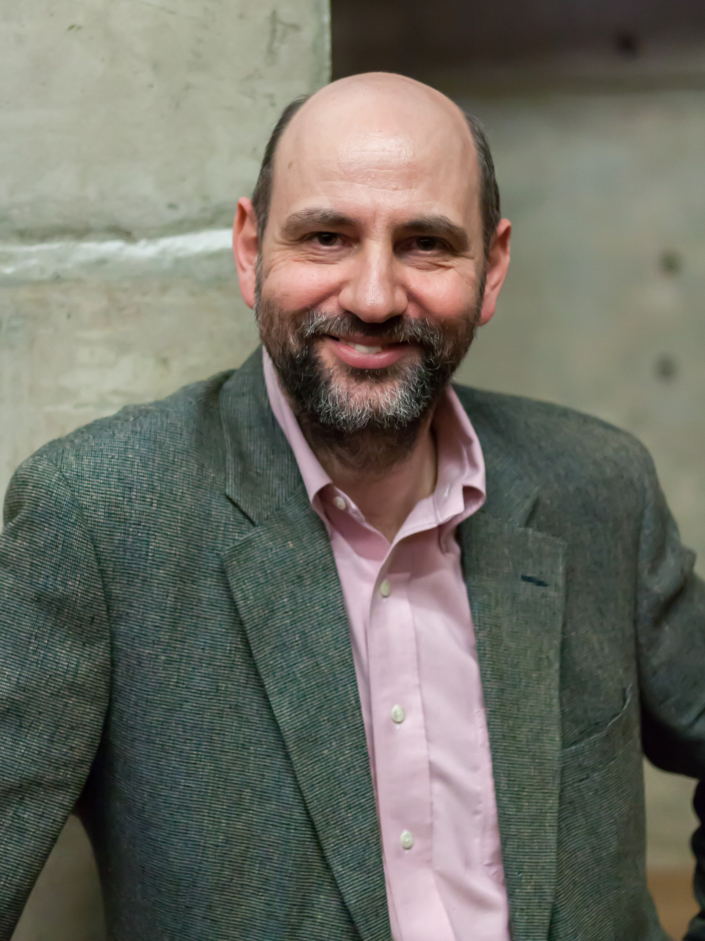
Software Engineering is about People
“Any fool can write code that a computer can understand. Good programmers write code that humans can understand”
- Martin Fowler

Slide 10
How do we write code that people can understand?
Depends on things like:
the size of the team
the size of the product
the longevity of the product
There's no one "right" way; there are always tradeoffs.
But there are best practices, which we will expect you to follow.

Slide 11
Learning Objectives for this course:
By the end of this course you will--
Be able to define and describe the phases of the software engineering lifecycle.
Be able to explain the role of key processes and technologies in modern software development.
Be able to productively apply instances of major tools used in elementary SE tasks.
Design and implement a portfolio-worthy software engineering project in a small team environment that can be showcased to recruiters.
Notes:
other factors: careful design, extensible solutions, effective teamwork, etc.

Slide 12
Approach
The course will mirror the steps of the software engineering life cycle
starting with requirements, through testing and deployment
we will move some material forward to make sure that you have the learning you need when you need it
Will start with several individual homework assignments
Then a group project, done in teams of about 4 people

Slide 13
Technology
We will use:
TypeScript as implementation language
Visual Studio Code as our IDE
REACT for web pages
Also git, and other miscellaneous tools

Slide 14
Course Mechanics
Our goal is to provide a productive learning environment to both remote and on-the-ground students
100% attendance is expected for both on-the-ground and remote sections
Classes will include both lectures and in-class activities.
Be sure to bring your laptop
Weekly slides will be posted in advance, so be prepared to ask and answer questions about the material.

Slide 15
Course Mechanics: In-Class Exercises and Tutorials
There will often be in-class exercises to give you practice with the technologies we will use.
In addition, there will be tutorials posted on the web.
Typically, will consist of structured steps that will guide you through a typical task

Slide 16
Course Mechanics (Wand section)
Professor Wand’s section will be remote-only.
Students in this section will be expected to leave their cameras ON for the duration of the class.
Students in this section will be expected to read the slides before coming to class.
Students in this section will be expected to come to class prepared with two questions to ask about the week’s material.

Slide 17
Course Requirements
There will be four homework assignments due during the first half of the term, plus a final project that will be due at the end of the term.
You will complete the assignments individually, and the project in a group of 4 or 5.
The overall grading breakdown is:
35% Homeworks
35% Team Project
10% Quizzes and in-class activities
20% Final Exam

Slide 18
Grade Appeal Policy
If you have concerns regarding the grading of your work, please let us know right away by opening a regrade request in GradeScope.
Do not post on Piazza or email your TA or instructor
GradeScope provides an interface that allows us to review all regrade requests in one place.
All regrade requests must be submitted within 7 days from your receipt of the graded work.
If your regrade request is closed and you feel that the response was not satisfactory, you may appeal to the instructor via email within 48 hours

Slide 19
Late Policy
Your work is late if it is not turned in by the deadline.
10% will be deducted for late HW assignments turned in within 24 hours after the due date
HW assignments submitted more than 24 hours late will receive a zero.
If you're worried about being busy around the time of a HW submission, please plan ahead and get started early.
If you have an accommodation from Disability Services, you must request it for each assignment.

Slide 20
Academic Integrity (1)
Students must work individually on all homework assignments.
We encourage you to have high-level discussions with other students in the class about the assignments, however, we require that when you turn in an assignment, it is only your work. That is, copying any part of another student's assignment is strictly prohibited.
If you steal someone else's work, you fail the class.
You are responsible for protecting your work. If someone uses your work, with or without your permission, you fail the class.

Slide 21
Academic Integrity (2)
You are free to reuse small snippets of example code found on the Internet (e.g. via StackOverflow) provided that it is attributed.
If you are concerned that by reusing and attributing that copied code it may appear that you didn't complete the assignment yourself, then please raise a discussion with the instructor.
If you are in doubt whether using others' work is allowed, you should assume that it is NOT allowed unless the instructors confirm otherwise.

Slide 22
Communication
Course web page (https://neu-se.github.io/CS4530-CS5500-Spring-2022)
Canvas
Canvas and the course web site will mirror each other.
Assignments, important notices, etc., will appear in both places.
Piazza (see Canvas for link)
for questions about assignments, etc.
Slack (for Prof. Wand’s section only)
For communication when we are in Zoom breakout rooms.

Slide 23
Review
Now that you've studied this lesson, you should be able to:
Explain what SE is and why it’s important
List your weekly obligations as a student
List the requirements for completing the course
Explain how assignments will be graded

Slide 24
OK, now let’s get down to work!
In our next lesson, we'll learn about the software-engineering life cycle.

